Slide 1
ENSEMBLE LEARNING
The science of combining models

Slide 2
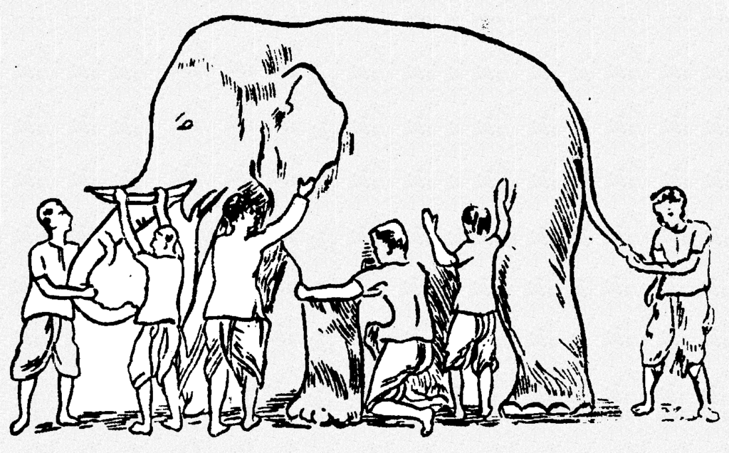
What is ensemble learning?
The wisdom of the crowd
A diverse set of models are likely to make better decisions as compared to single models
Combining decisions from multiple models to improve the overall performance.
Some unkown distribution
Model 6
Model 4
Model 2
Model 1
Model 3
Model 5

Slide 3
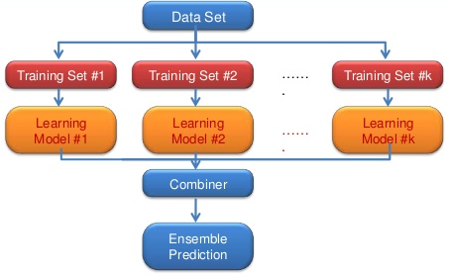
What is ensemble learning?
An ensemble is a group of predictors
An ensemble can be a strong learner even if each predictor is a weak learner
Provided there are a sufficient number of weak learners and they are sufficiently diverse

Slide 4
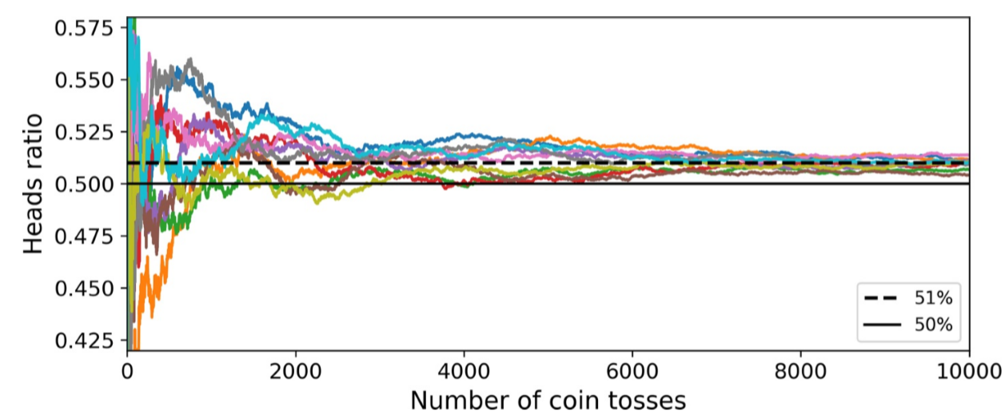
How will combining leads to a strong learner?
Think of a slightly biased coin with 51% chance of heads and 49% of tails.
Law of large numbers: as you keep tossing the coin, assuming every toss is independent of others, the ratio of heads gets closer and closer to the probability of heads 51%.

Slide 5
How will combining leads to a strong learner?
Tossing the coin 1000 times, we will end with more or less than 510 heads and 490 tails.
For an ensemble of 1000 classifiers, each correct 51% of the time, the probability of getting the majority of heads is up 75%

Slide 6
Ensemble Learning
Different types of ensembles
Use the same/different learning algorithms
Homogeneous vs heterogeneous ensembles
Use the same dataset/ random subsets of data
Use the same/different sets of features
Voting
Bagging and Pasting
EL approaches
Boosting
Stacking

Slide 7
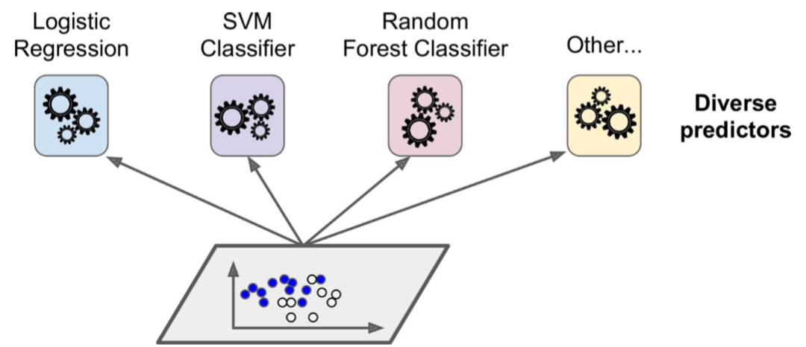
Voting Classifier
Train diverse predictors on the same data

Slide 8
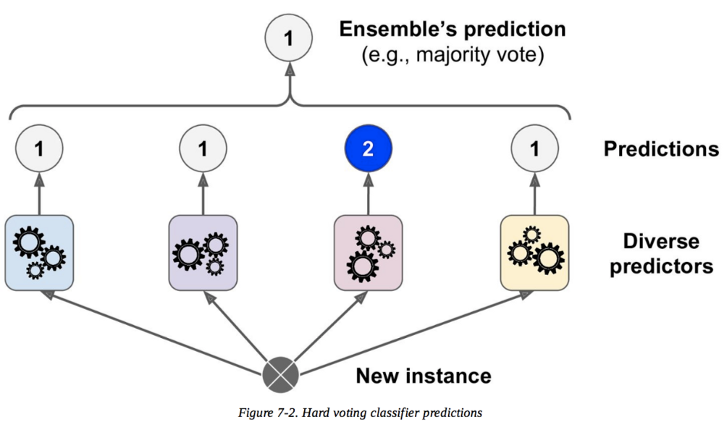
Voting Classifier
Use voting for predictions
Hard voting:
The ensemble prediction is the prediction of the majority
Predictor 1 | Predictor 2 | Predictor 3 | Predictor 4 | Predictor 5 | Ensemble’s prediction
5 | 4 | 5 | 4 | 4 | 4
Example

Slide 9
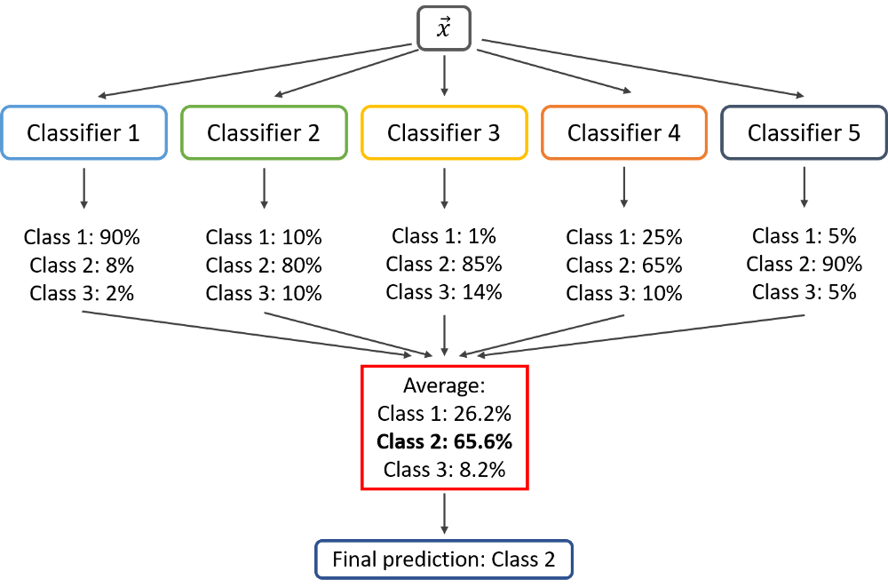
Voting Classifier
Use voting for predictions
Soft voting:
The ensemble prediction is the class with the highest averaged probability averaged

Slide 10
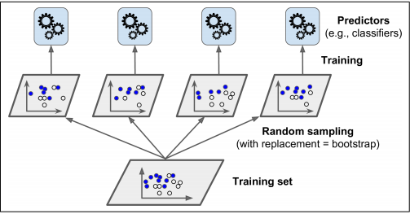
Bagging and Pasting
Use different random subset of samples
Usually predictors of the same type are used
Bagging: sampling with replacement
For a given predictor, a training instance may be sampled several times
Pasting: sampling without replacement
Training instances may be sampled several times across predictors
Training and predictions can be performed in parallel

Slide 11
Example of Bagging
Original data | 1 | 2 | 3 | 4 | 5 | 6 | 7 | 8 | 9 | 10
Sample size = 10
Bootstrap 1
Bootstrap 2
Bootstrap 3
7 | 8 | 10 | 8 | 2 | 5 | 10 | 10 | 5 | 9
1 | 8 | 5 | 10 | 5 | 5 | 9 | 6 | 3 | 7
1 | 4 | 9 | 1 | 2 | 3 | 2 | 7 | 3 | 2
Model 1
Model 2
Model 3
Combined prediction

Slide 12
Example of Pasting
Original data | 1 | 2 | 3 | 4 | 5 | 6 | 7 | 8 | 9 | 10
Sample size = 6
Sample 1
Sample 2
Sample 3
7 | 8 | 10 | 1 | 2 | 3
1 | 8 | 5 | 10 | 9 | 6
1 | 4 | 9 | 2 | 3 | 7 | 6
Model 1
Model 2
Model 3
Combined prediction

Slide 13
Random Subspaces and Random patches
X1 | X2 | X3 | X4 | X5
1 | 10 | 21 | 30 | 44 | 15
2 | 12 | 20 | 35 | 40 | 20
3 | 10 | 24 | 34 | 43 | 14
4 | 15 | 22 | 31 | 41 | 12
5 | 19 | 25 | 35 | 42 | 19
6 | 12 | 29 | 30 | 45 | 11
Random Subspaces
Random Patches
1 | 21 | 44 | 15
2 | 20 | 40 | 20
3 | 24 | 43 | 14
4 | 22 | 41 | 12
5 | 25 | 42 | 19
6 | 29 | 45 | 11
1 | 10 | 30 | 44
2 | 12 | 35 | 40
3 | 10 | 34 | 43
4 | 15 | 31 | 41
5 | 19 | 35 | 42
6 | 12 | 30 | 45
1 | 10 | 21 | 30
2 | 12 | 20 | 35
3 | 10 | 24 | 34
4 | 15 | 22 | 31
5 | 19 | 25 | 35
6 | 12 | 29 | 30
1 | 10 | 21 | 30 | 44 | 15
3 | 10 | 24 | 34 | 43 | 14
4 | 15 | 22 | 31 | 41 | 12
5 | 19 | 25 | 35 | 42 | 19
2 | 12 | 20 | 35 | 40 | 20
3 | 10 | 24 | 34 | 43 | 14
4 | 15 | 22 | 31 | 41 | 12
6 | 12 | 29 | 30 | 45 | 11
1 | 10 | 21 | 30 | 44 | 15
4 | 15 | 22 | 31 | 41 | 12
5 | 19 | 25 | 35 | 42 | 19
6 | 12 | 29 | 30 | 45 | 11
Sampling both instances and Features
Keep all instances and sample Features

Slide 14
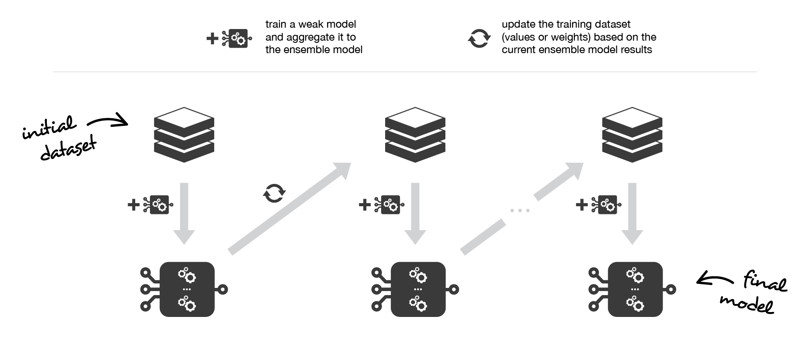
Boosting
Unlike bagging, individual predictors are trained sequentially, each trying to correct its predecessor.

Slide 15
Adaboost (Adaptive boosting)
Instead of sampling, re-weigh samples
Samples are given weights.
Start with uniform weighting
At each iteration, a model is learned and the samples are re-weighted so the next classifiers focus on samples that were wrongly predicted by previous classifier
Weights of correctly predicted samples are decreased
Weights of incorrectly predicted samples are increased
Final prediction is a combination of model predictions weighted by their respective error measures

Slide 16
Adaboost
Original data D1
Weighted data D2
Weighted data D3
4
1
4
1
4
1
5
2
2
5
2
5
Combined Classifier
5
1
5
1
5
1
2
2
2
3
3
4
1
3
3
3
3
2
4
4
4
5
Classifier 3
5
1
Classifier 1
Classifier 2
2
3
3
4
1
4
1
4
2
4
1
5
2
5
2
5
5
1
5
1
5
1
2
2
2
3
3
3
3
3
3
4
4
4

Slide 17
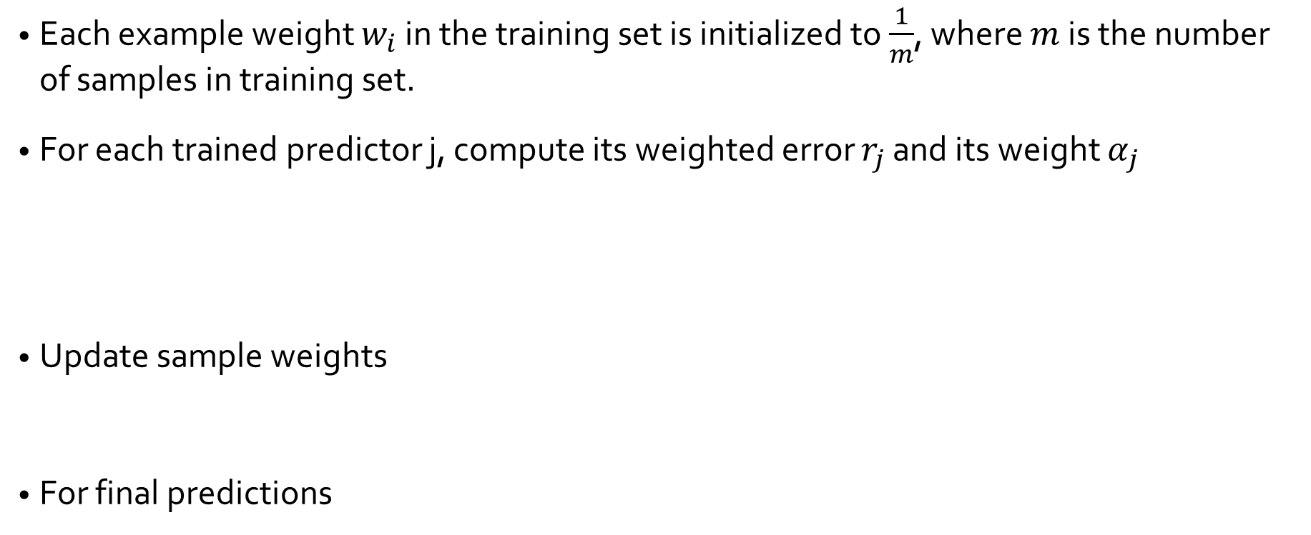
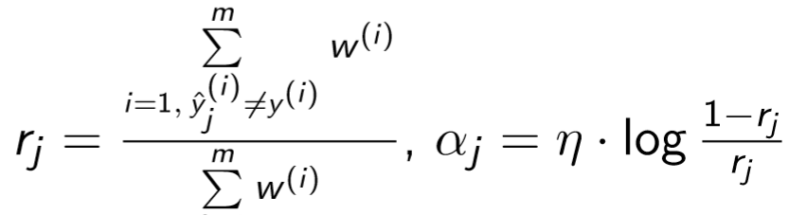
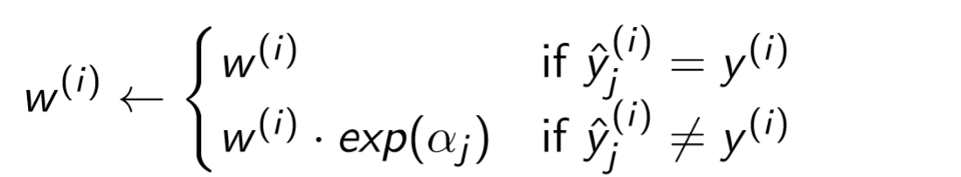
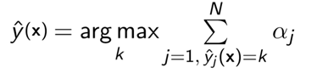
Adaboost algorithm

Slide 18
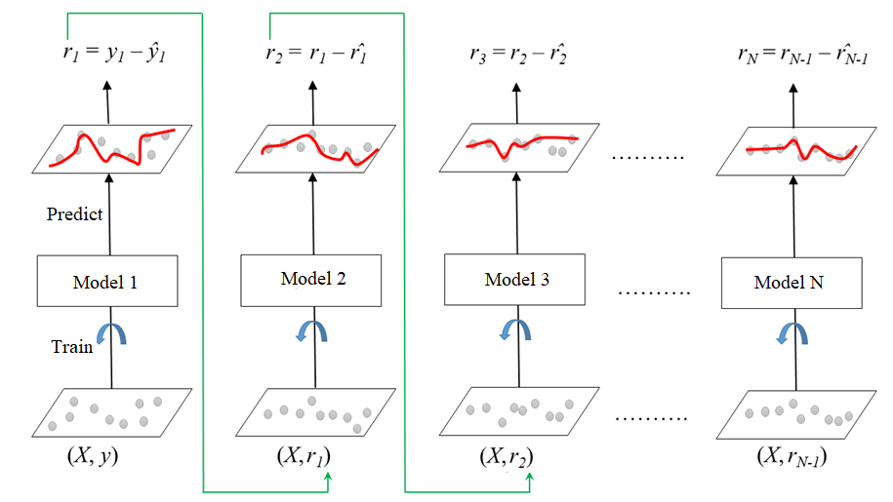
Gradient Boosting
Unlike AdaBoost, Gradient Boosting tries to ﬁt the new predictor to the residual errors made by the previous predictor.

Slide 19
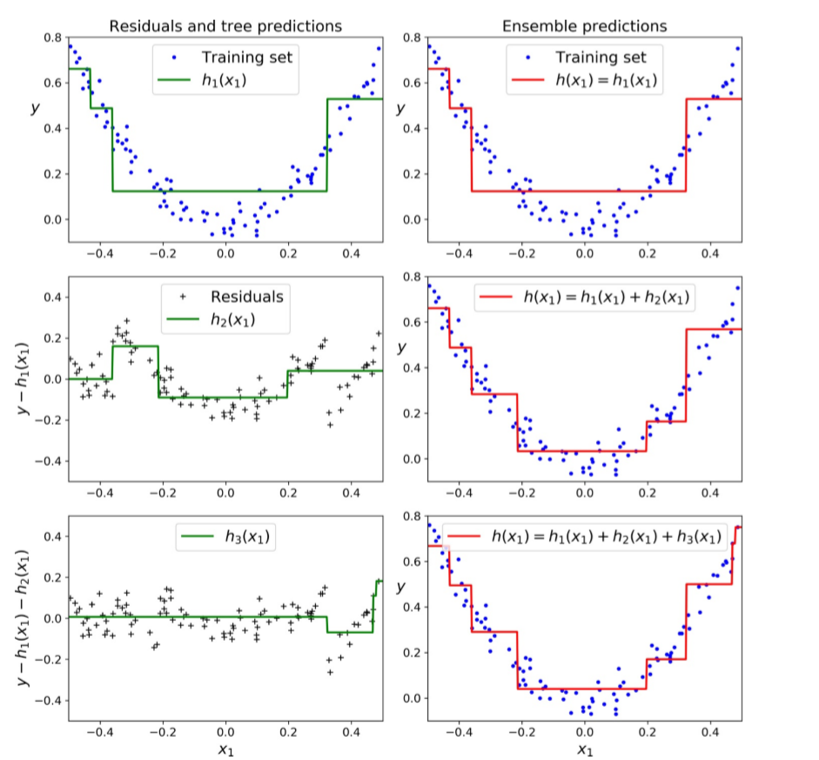




Gradient Boosting

Slide 20
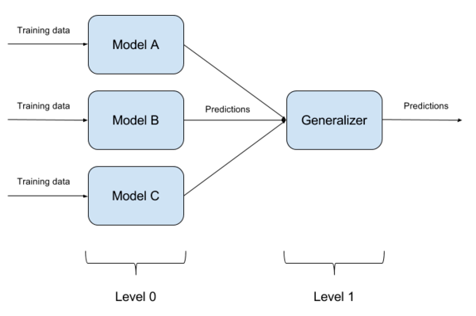
Stacking (Stacked generalization)
Basic idea:
Train a separate model to perform aggregation of the predictions of the individual classifiers
Predictions from the train set are used as features for level 1 model.
Level 1 model is used to make a prediction on the test set
Blender or meta-learner

Slide 21
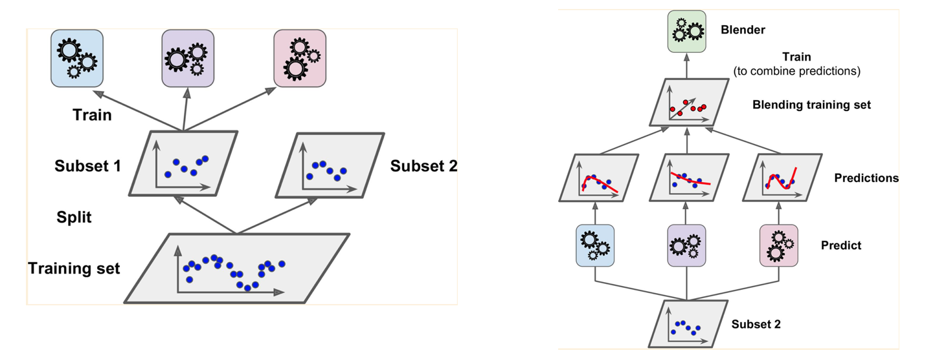
Stacking (Stacked generalization)
Stacking with a hold-out set 🡪 Blending

Slide 22
Stacking
Model 1
Training level 0 models
Training Subset 1
X1 | X2 | X3 | X4 | C
x_{1,1} | x_{2,1} | x_{3,1} | x_{4,1} | True
x_{1,2} | x_{2,2} | x_{3,2} | x_{4,2} | False
… | … | … | … | …
x_{1,i} | x_{2,i} | x_{3,i} | x_{4,i} | True
train
Model 2
Training set
X1 | X2 | X3 | X4 | C
x_{1,1} | x_{2,1} | x_{3,1} | x_{4,1} | True
x_{1,2} | x_{2,2} | x_{3,2} | x_{4,2} | False
… | … | … | … | …
x_{1,n} | x_{2,n} | x_{3,n} | x_{4,n} | False
Model 3
Training Subset 2
X1 | X2 | X3 | X4 | C
x_{1,i+1} | x_{2,i+1} | x_{3,i+1} | x_{4,i+1} | True
x_{1,i+2} | x_{2,i+2} | x_{3,i+2} | x_{4,i+2} | False
… | … | … | … | …
x_{1,n} | x_{2,n} | x_{3,n} | x_{4,n} | True

Slide 23
Stacking
Model 1
Model predictions
True targets
Training Subset 2
X1 | X2 | X3 | X4 | C
x_{1,i+1} | x_{2,i+1} | x_{3,i+1} | x_{4,i+1} | True
x_{1,i+2} | x_{2,i+2} | x_{3,i+2} | x_{4,i+2} | False
… | … | … | … | …
x_{1,n} | x_{2,n} | x_{3,n} | x_{4,n} | True
M1 | M2 | M3 | C
True | True | False | True
False | True | True | False
… | … | … | …
True | False | True | True
predict
Model 2
Model 3
Training set for level 1 model
Generalizer
Final predictions

Slide 24
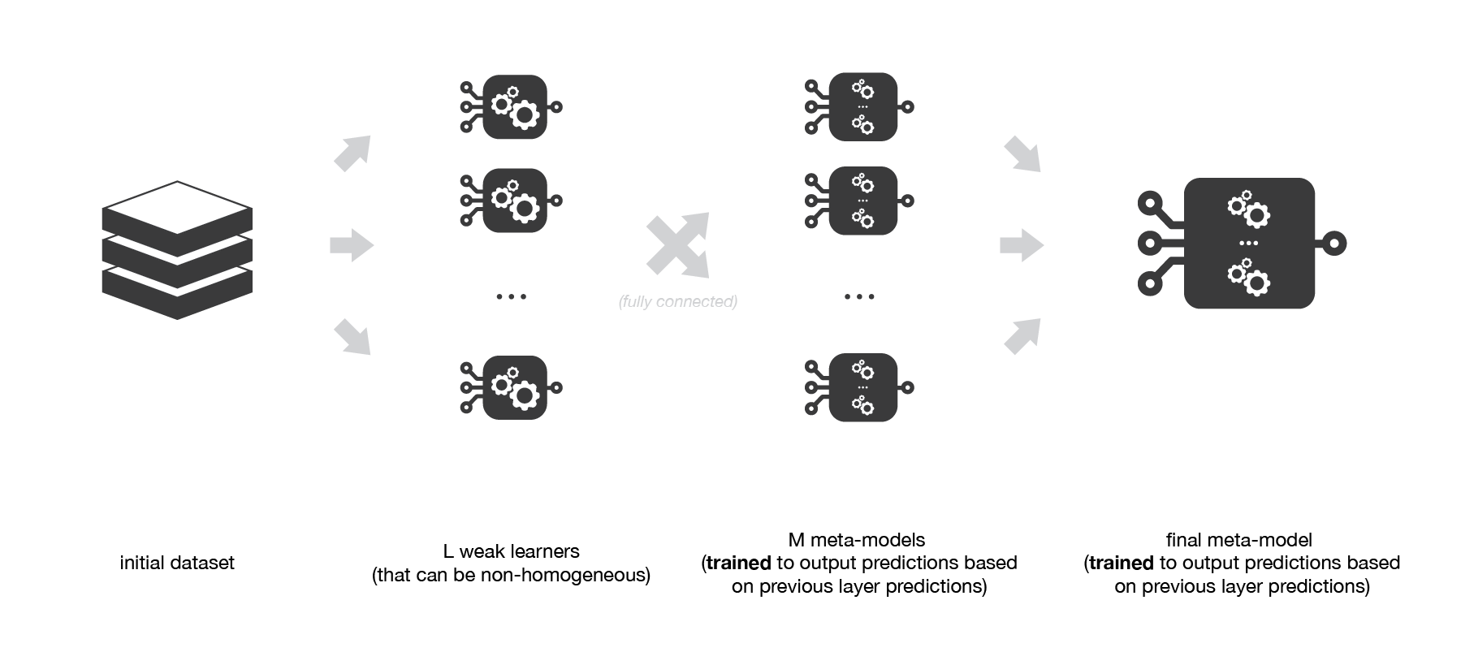
Multilayer stacking

Slide 25
Conclusions
Ensemble learning is about training multiple base models and combined them to obtain a strong model with better performance
Ideally low bias, low variance
In bagging ensembles, instances of the same base model are trained in parallel on random subsets of data and then aggregated
Using random sampling reduce variance
In boosting ensembles, instances of the same base model are trained iteratively, such that, each model attempts to correct the predictions of the previous model.
Stacking ensembles use multi-stage training. Different types of base models are trained at the very first stage on top of which a meta-model is trained to make predictions based on based model predictions

